Slide 1
Baja SAE Technical Bulletin
2017-1: Transponder Types & Cost Reporting

Slide 2
Introduction
This bulletin will cover:
List of available for transponders compatible with Baja SAE official timing systems
Information about how to report the cost of your Transponder(s) in the Cost Report
Details that can help you compare allowed transponder types if deciding what to purchase

Slide 3
Transponder Reported Cost
Reminders: As of 2016:
Transponders are NOT be included in the Cost Report
If you accidently include one or more transponders in your cost report, we will exclude those lines during the cost report processing
This applies to all types of accepted transponders regardless of how much and how often you pay for them

Slide 4
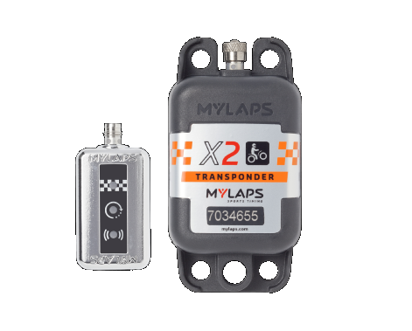
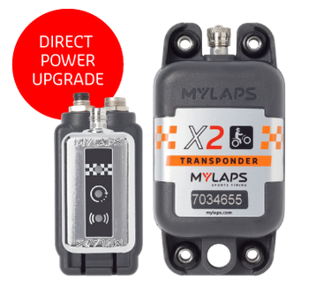
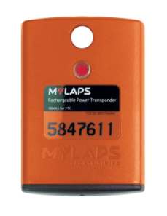
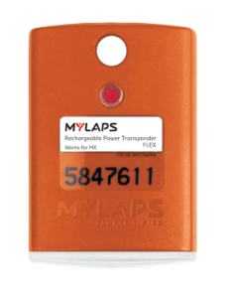
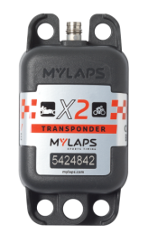
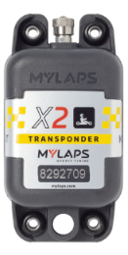
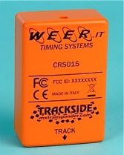
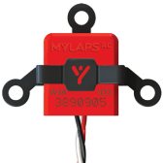
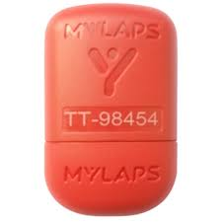
Types of Transponders
X2 MX w/
Direct Power
MX Classic
MX Flex
X2 MX
MyLaps Non-MX Classic & Flex
MX Car/Bike or Kart
Other
Brands

Slide 5
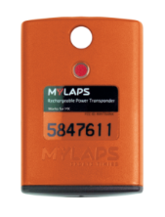
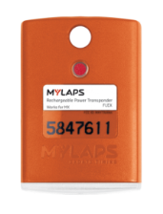
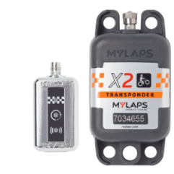
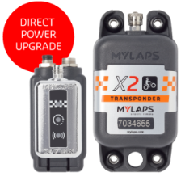
Details on Allowed Transponders
 | Allowed Transponders
Transponder Name | MX Classic | MX Flex | X2 MX Rechargeable | X2 MX Direct Power
Picture
Price Model | One Time Purchase | 1, 2 or 5 Year Subscription | 1, 2 or 5 Year Subscription | 1, 2 or 5 Year Subscription
Sales Availability | No Longer Available | No Longer Available | Currently Available | Currently Available
Renewal Availability | -- NA -- | 1, 2 or 5 Year | 1, 2 or 5 Year | 1, 2 or 5 Year
MyLaps’ End of Support | 1-6-2017 | 1-6-2017 | Ongoing | Ongoing
MyLaps’ End of Service | 1-6-2019 | 1-6-2019 | Ongoing | Ongoing
Insurance Included | No | Yes, With Subscription | Yes, With Subscription | Yes, With Subscription
Warranty Included | 3-year Limited Warranty | Unlimited warranty | Unlimited warranty | Unlimited warranty
Mounting Type | Classic Quick Release Clip | Classic Quick Release Clip | X2 Quick Release Clip | Direct Mount + Cable Harness
Power Source / Time on Battery | Rechargeable / 4 Days | Rechargeable / 5 Days | Rechargeable / 5 Days | Direct Power (12V) With Built in Battery Backup
Time Needed to Charge | 16 Hours | 16 Hours | 4 Hours | -- NA --
Charger Type | Black 12V Cradle | White 5V USB Cradle | 5V USB X2 RaceKey | -- NA --

Slide 6
Summary
Don’t include any transponders in your Cost Report
Use one or two of the allowed transponders
If you are unsure about a rule, you can make use of the Rules Question feature on BajaSAE.net, or ask fellow competitors on the BajaSAE.net forums.

